Slide 1
Hoobic Limted Project
HR App dashboard development
By
Chile
Chukwuyem
Oladapo
Shweta
Saheed
Adedolapo

Slide 2
Overview of the Business
Hoobic Limited is creating a user-friendly HR dashboard to provide its clients with real-time insights into critical HR functions such as recruitment, productivity, performance, remuneration, and financial metrics. The dashboard's plug-and-play capability ensures easy integration for a seamless user experience, enhancing HR decision-making and strategic planning for Hoobic's diverse clientele.

Slide 3
Key Objectives
Create and introduce an intuitive, ready-to-use HR dashboard for Hoobic Limited's clients, designed to improve decision-making by providing insightful analytics on crucial HR metrics.

Slide 4
Project Scope
Design: Crafting a user-friendly interface for the HR dashboard that allows intuitive navigation and interaction, tailored to the needs of HR professionals.
Development: Building the HR dashboard with robust functionality that supports plug-and-play features.
Integration: Ensuring the dashboard seamlessly aggregates data from various HR processes and systems, providing a consolidated view of key metrics.
Data Metrics Implementation: Incorporating functionalities to track and analyze specified HR metrics, including recruitment, productivity, performance, remuneration, and finance.
Testing: Conducting comprehensive testing to ensure reliability, accuracy, and user satisfaction with the dashboard.
Deployment: Implementing the dashboard in the client's environment, ensuring it is fully operational and accessible.
Training: Providing initial training sessions for Hoobic Limited's clients to maximize their ability to utilize the dashboard effectively.
Compliance: Ensuring the dashboard adheres to data security and privacy regulations, protecting sensitive information.

Slide 5
Key Activities Overview
Requirement gathering & elicitation from key stakeholders and documentation.
Creation of Business analysis plan, stakeholder register, Governance policy, Risk Register, business case, Change Management Plan, scope document and all other relevant documentation.
Creation of Prototype of solution, Use case diagram, user stories and acceptance criteria.
Generated data from scratch, analyzed to meet stakeholder requirements.
Utilize structural query Language SQL to define and manipulate data to meet requirement purpose.
Created a dashboard with relevant KPI’s to track HR performance.

Slide 6
Objective
Develop and launch a user-friendly, plug-and-play HR dashboard for Hoobic Limited’s clients that enhances decision-making across key HR metrics.

Slide 7
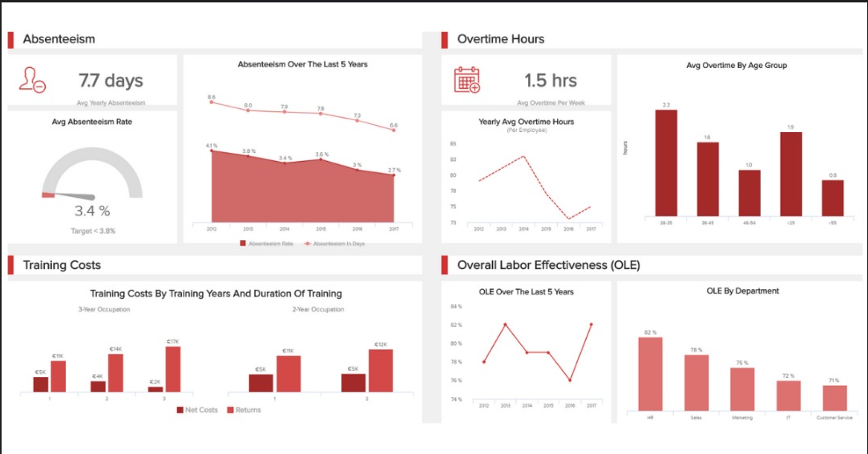
Prototype/Design

Slide 8

Development
Features of this Dashboard was based on stakeholder's requirements.
Average sales
Average salaries
Average cost per hire
Days to fill versus open positions
Absence ratio

Slide 9
Integration
We commenced with the creation of sophisticated SQL queries to accurately extract essential metrics for human resource tracking. Following this initial step, a second set of advanced SQL scripts was meticulously developed within the Power BI environment. This allowed for a seamless migration of data from the SQL database directly into Power BI, setting the foundation for in-depth data analysis and dynamic dashboard visualizations.

Slide 10
Data Metrics Implementation
Recruitment:
Developed dynamic visualizations that track the entire recruitment cycle, from job postings to time-to-hire.
We will be tracking; Average cost per hire and Average number of days to hire
Productivity:
Create a module within the dashboard that represents employee productivity, possibly using key performance indicators like average task completion time or output per employee. We will be tracking absence rate and overtime rate.
Performance:
Design an interface to visualize performance evaluations, goal achievements, and progress over time. We will tracking performance management index and high performers turnover rate
Remuneration:
Incorporate data visualization for salary distributions, bonuses, benefits, and raise cycles, with comparative analysis features to industry or regional benchmarks. We will be tracking average rate per employee and Compa-ratio
Finance:
Provide financial reporting specific to HR, such as payroll expenses, training costs, benefits payouts, and forecast return on investment for HR initiatives. We will be tracking revenues per employee, profits before tax per employee, human capital ROI and human capital added value

Slide 11
Testing
Unit Testing: Testing individual visuals for correct behaviour.
Integration Testing: Ensuring different parts of the dashboard worked together seamlessly.
System Testing: Evaluating the complete and integrated system against specified requirements.
Performance Testing: Assessing the dashboard's responsiveness and stability under various conditions.
User Acceptance Testing (UAT): Conducted with actual end-users to confirm the system met their requirements and was ready for deployment.

Slide 12
Deployment
Preparation:
Ensuring that the client’s infrastructure supports Power BI services.
Setting up necessary permissions and security protocols.
Publishing:
Uploading the Power BI dashboard file (.pbix) to the client's Power BI service.
Configuring the dashboard settings, such as data refresh schedules.
Data:
Establishing and verifying data sources or datasets within the client’s system.
Ensuring that data flows smoothly and accurately from the sources to the dashboard.
Validation:
Conducting a final check to confirm that all visuals and data representations are displaying correctly.
Validating the dashboard’s functionality with a subset of end-users.
Access Control:
Assigning user roles and access rights within the Power BI environment to maintain data security.
Setting up groups or distribution lists for sharing the dashboard with relevant stakeholders.
Training and Support:
Providing training sessions for the client’s team to familiarize them with the dashboard’s features and capabilities.
Setting up support channels for ongoing assistance with any operational issues.
Monitoring and Feedback:
Monitoring the dashboard's performance and user adoption post-deployment.
Collecting user feedback for potential improvements or adjustments.

Slide 13
Training
Providing training sessions to familiarize them with the dashboard’s features and capabilities.
Setting up support channels for ongoing assistance with any operational issues.

Slide 14
Compliance
This project complies with relevant data regulations and privacy standards.
All the data used in this project has been handled in accordance with applicable laws and regulations and generated solely for Hoobic Ltd and does not reflect or represent the data of any specific company.

Slide 15
Monitoring and Feedback:
Monitoring the dashboard's performance and user adoption post-deployment.
Collecting user feedback for potential improvements or adjustments.

Slide 16
Data Privacy, Governance and security
Please note the following:
This report is prepared solely for academic purposes and does not reflect or represent the data of any specific company or individual.
•The data used for the purpose of this analysis were generated randomly from scratch. The use of SQL (DDL & DML) was employed to create schemas, tables, and data points for analytical purposes only.
Access to data is restricted on a need-to-know basis, with appropriate authentication, authorization, and encryption mechanisms in place to safeguard data integrity and confidentiality.
This presentation complies with relevant data regulations and privacy standards.
All data used in this presentation has been has been handled in accordance with applicable laws and regulations and generated solely for academic purposes and does not reflect or represent the data of any specific company

Slide 17
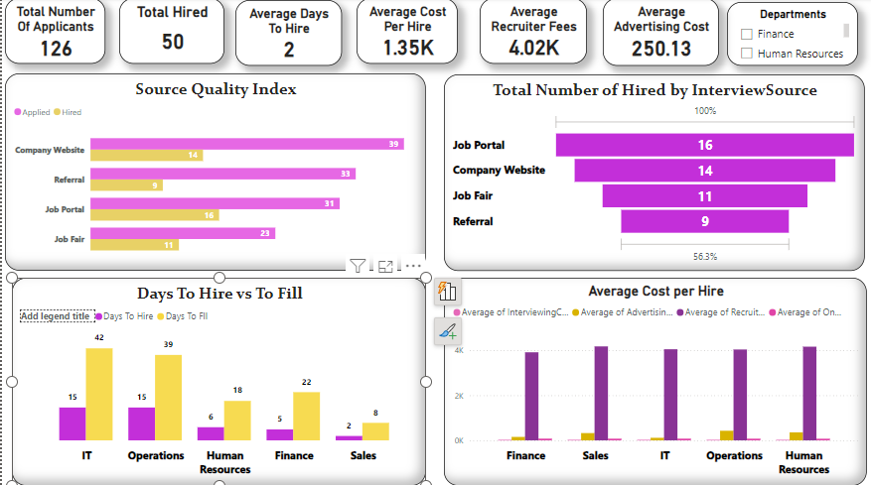
Recruitment

Slide 18
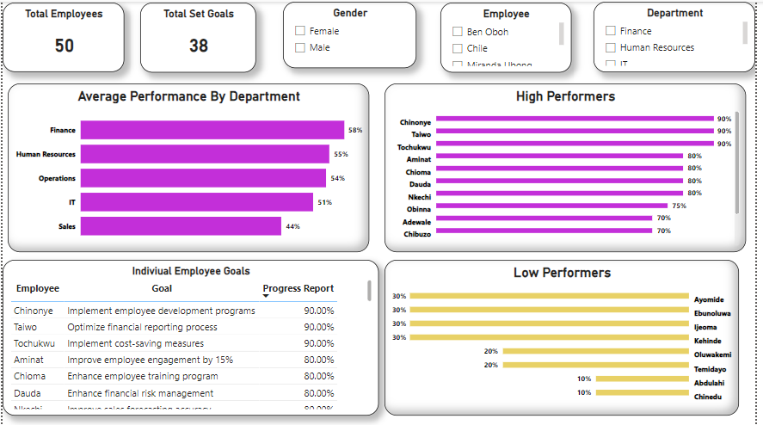
Performance

Slide 19
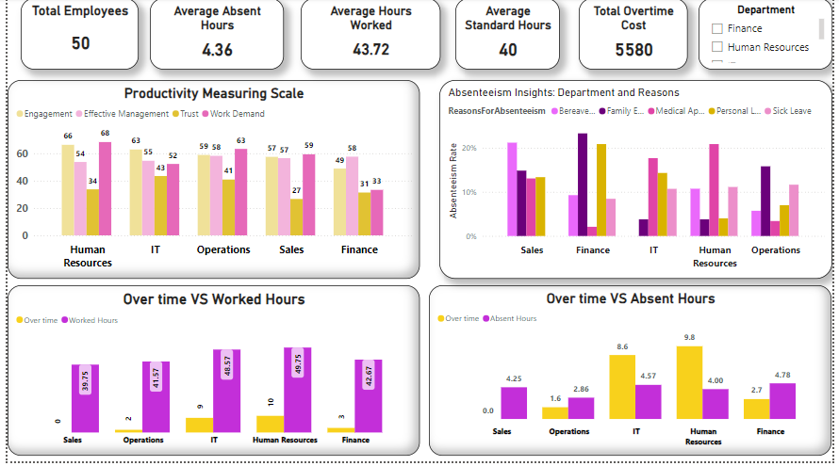
Productivity

Slide 20
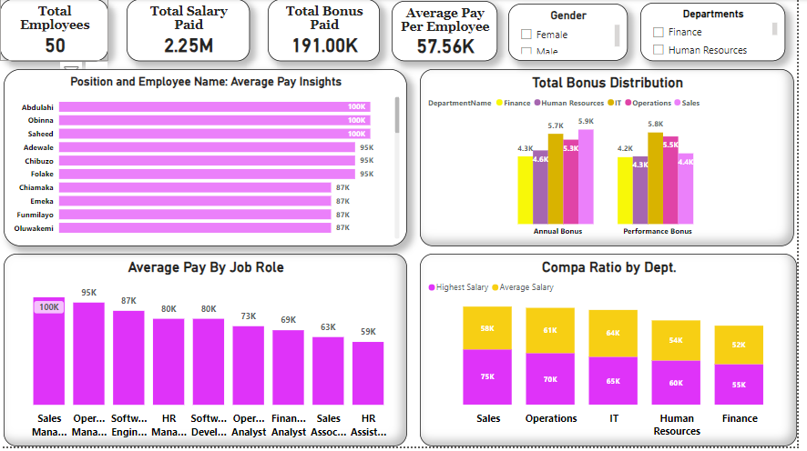
Remuneration

Slide 21
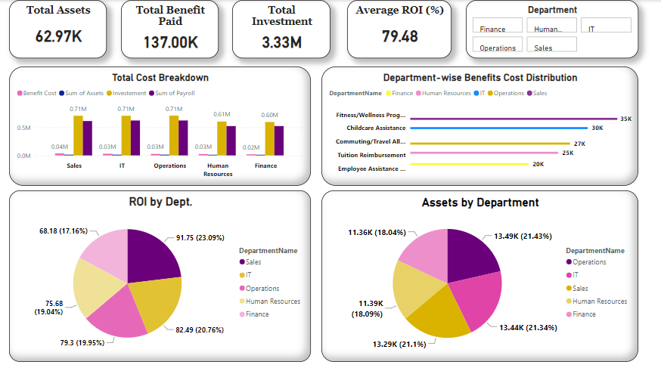
Finance

Slide 22
Thank You
We appreciate your attention and are open to any questions.

Slide 23
Appendix
The appendix contains screen shot of the one drive folder with all relevant documentation .

